Slide 1
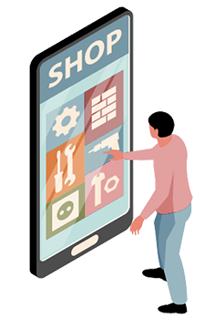
Handicraft’s Galaxy
Get your favourite’s at your doorstep

Slide 2

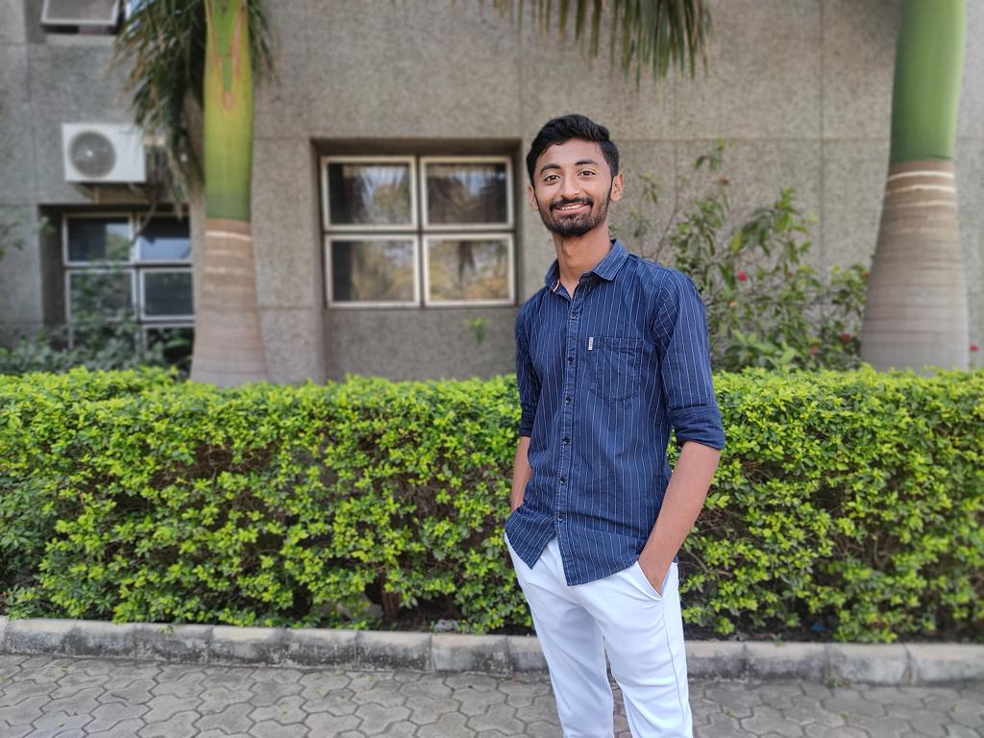
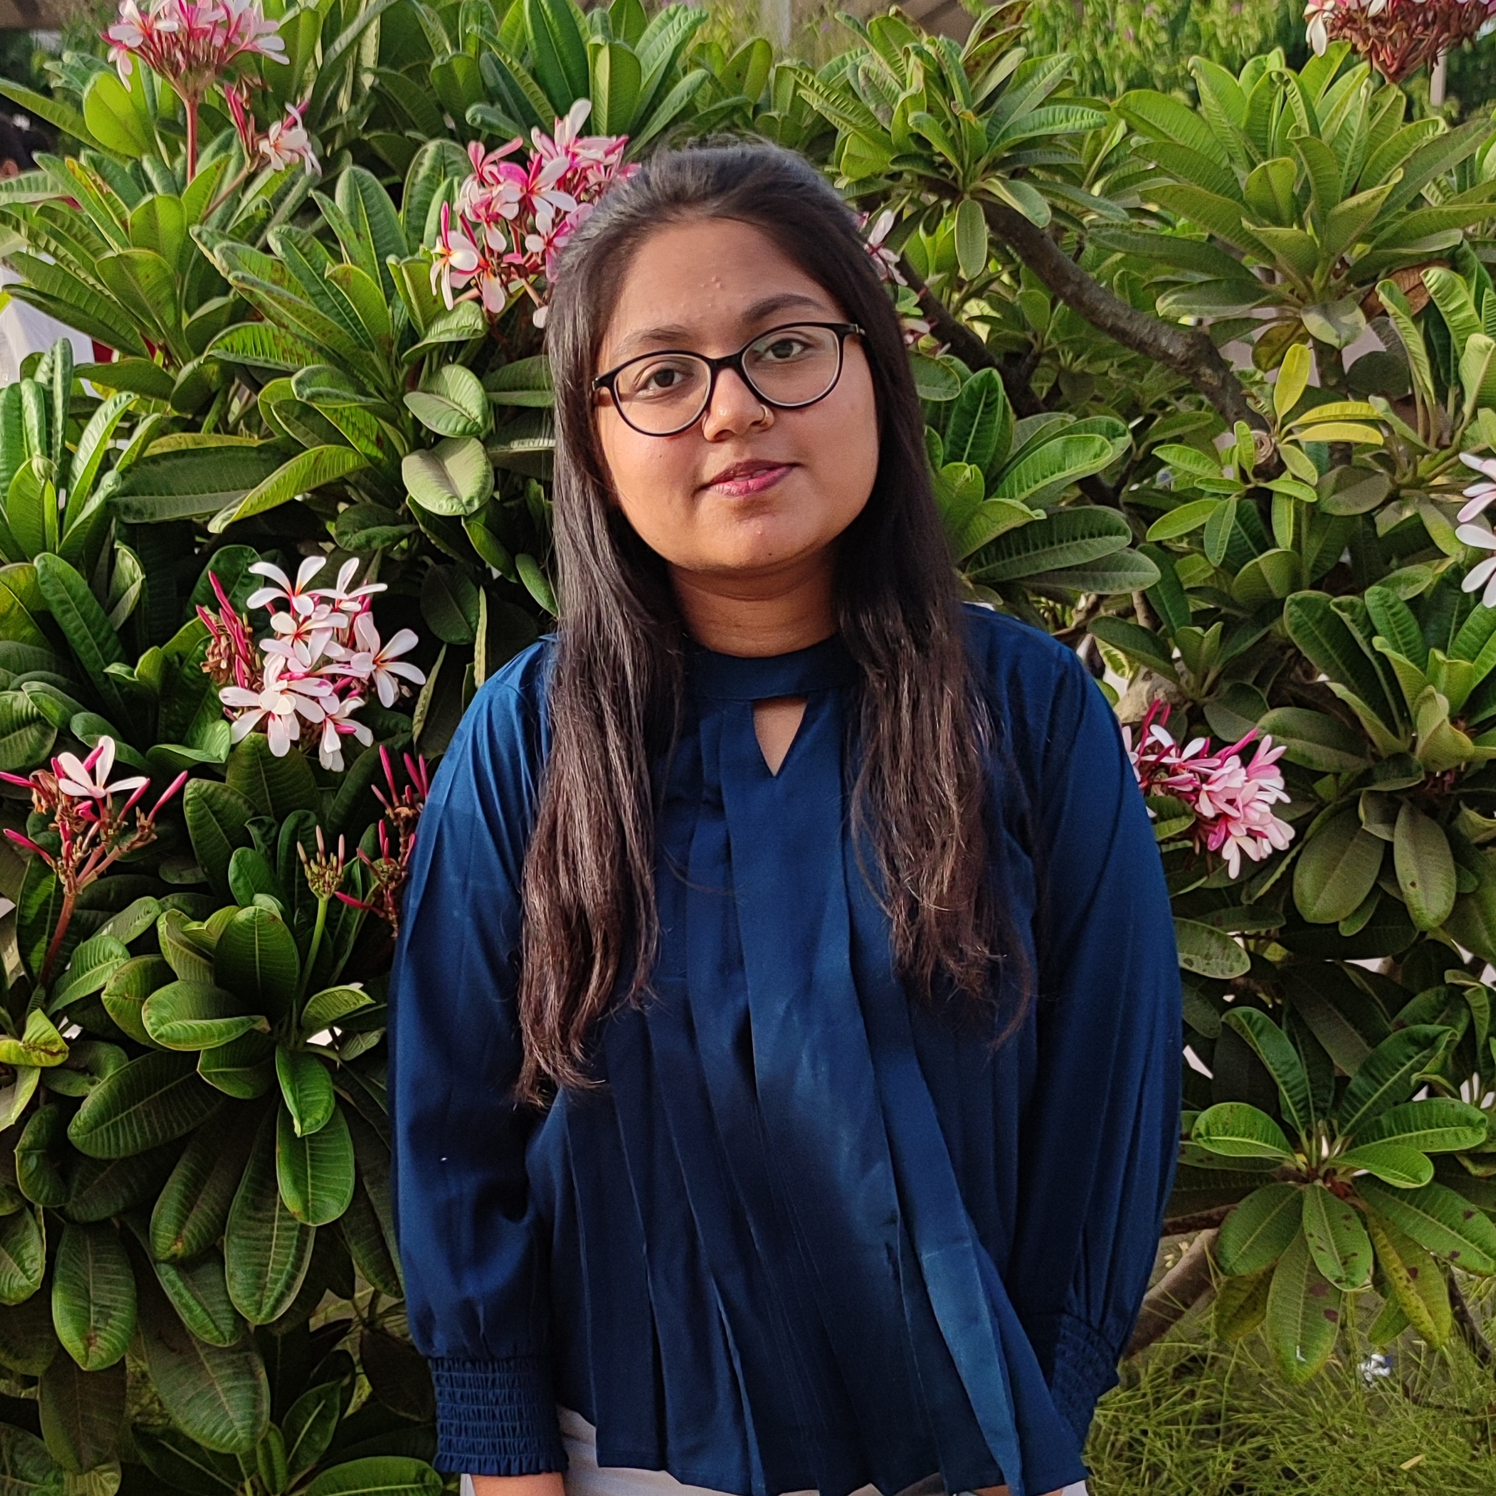
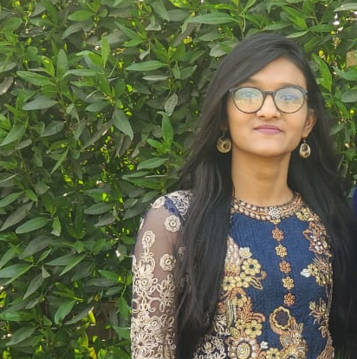
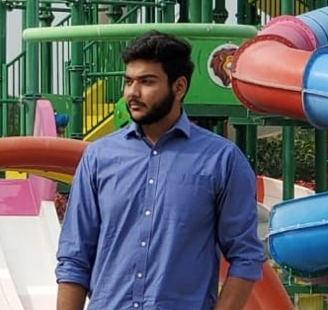

OUR TEAM
Avinash Chovatiya
Krishna
Antala
Hetvi
Vadalia
Sahil
Gajera
20SOECE11083
5CEB
20SOEIT11002
5ITA
20SOECE11073
5CEB
20SOEIT11008
5ITA

Slide 3
TABLE OF CONTENTS
01
02
03
Work Distribution
Final Definition
Needs of Project
04
05
06
Prototype
Analysis Model
Limitations & Future
Work done by our team members
Definition of application to be developed by our team
Needs of the application which we are going to develop
Design of our application
Flow chart & Diagrams
Limitations and future enhancement of application

Slide 4

01
WORK DISTRIBUTIONS
Work done by our team members

Slide 5
WORK BENCH
AVINASH CHOVATIYA | KRISHNA ANTALA | HETVI VADALIA | SAHIL GAJERA
WIRE FRAME | WIRE FRAME | SRS | SRS
ACTIVITY DIAGRAM | USECASE DIAGRAM | DFD LEVEL 0,1,2 | FLOWCHART
SEQUENCE DIAGRAM | PPT | CLASS DIAGRAM | PPT

Slide 6
02
FINAL DEFINITION
Application that will be developed by our team as our project.
SOURCE
Our Own Idea

Slide 7
Handicraft’s Galaxy
A place from where handicraft loving customers will be able to buy products online so that, they don’t need to visit store everytime.
This app will allow users to shop handmade crafts online from their smart phones sitting at their premises without stepping out by saving their time and energy.
It will provide all features starting from previewing products to order and receive delivery of products.

Slide 8
03
NEED OF THIS APP
Why we are developing this application

Slide 9
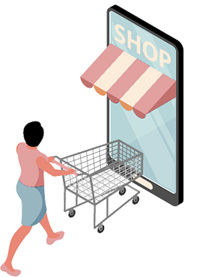
WHY ?
Comfort of Customers
Digitalization
Market Gap
Expand Business

Slide 10
SCOPE OF THE PROJECT
USES
DEFINITION
AFFECT
The E-Commerce Handicraft application is converting the offline shopping to online application based so that user can easily get the products from their home.
It can be used by the user for shopping as well as by the seller/admin to keep tabs of the progress and their growth.
This will help in expanding the business with the help of current technology.

Slide 11
Requirements
Android Studio
Application Development
Java/XML
Backend/Frontend Development
Database
Firebase
Android SDK
For using/deploying application or testing
64-bit Microsoft Windows 8+
Run Android Studio
x86_64 CPU architecture
2nd Generation Intel Core or AMD CPU
RAM | ROM
4 GB or more ram | 8GB disk space
Android Device or Emulator
For deploying or testing

Slide 12
Dependencies
implementation 'com.google.android.material:material:1.6.1’
implementation 'com.google.firebase:firebase-auth:21.0.8’
implementation 'com.google.firebase:firebase-database:20.0.6’
implementation 'com.hbb20:ccp:X.Y.Z'

Slide 13
04
PROTOTYPE
Design of our Application

Slide 14
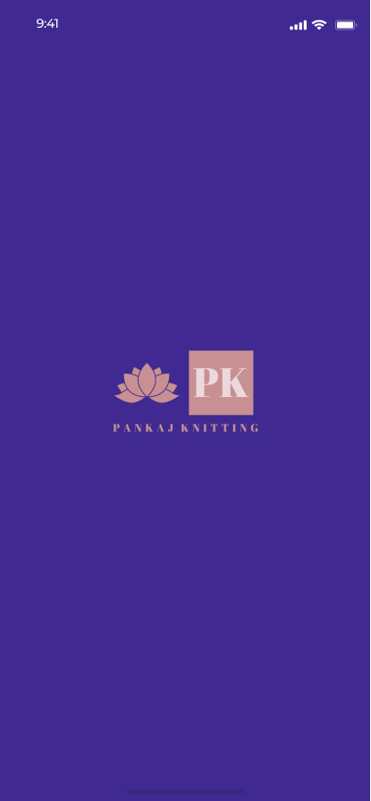
SPLASH SCREEN
Displayed for shorter period on opening application.

Slide 15

WELCOME
Welcome screen will be displayed when new user will open the app.
Get Started button will take the user to Sign-In screen.

Slide 16
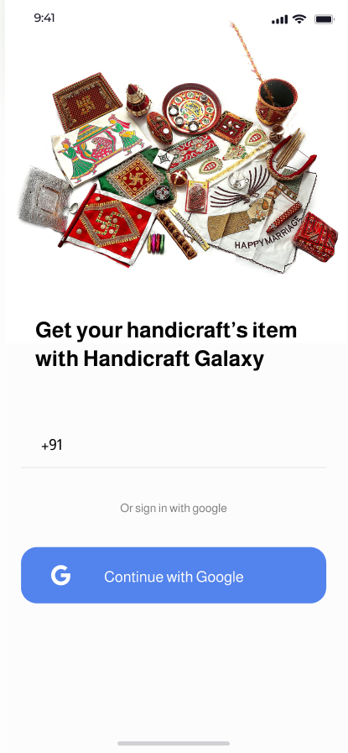
SIGN IN
User has two option to sign into our app- either Mobile Number or with Google.
Selecting Mobile Number will go for OTP verification and With Google will link your google account to sign-in.

Slide 17
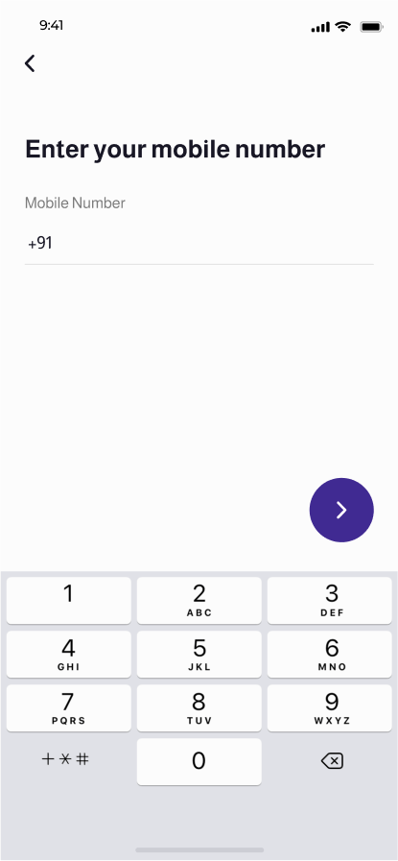
NUMBER
On previous screen, if the user clicks on textbox to enter mobile number, will be redirected here.
After entering number and hitting next button, the user will receive OTP on entered number and redirected to next screen.

Slide 18
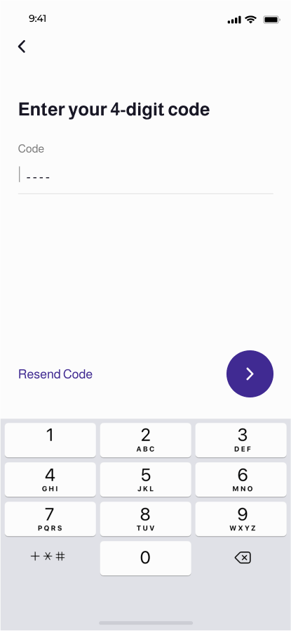
VERIFICATION
User must enter correct OTP here received from previous process and hit the next button to proceed to sign-in to our app.

Slide 19
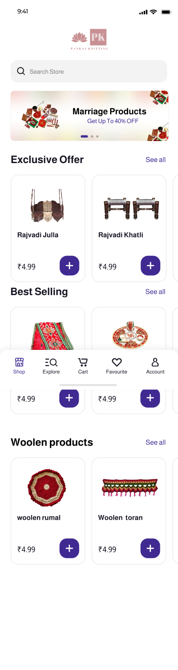
HOME SCREEN
This screen will be displayed after successful sign-in to app.
It contains search bar in which user can search products from store.
And few category groups like best-selling products, various offers, etc.

Slide 20
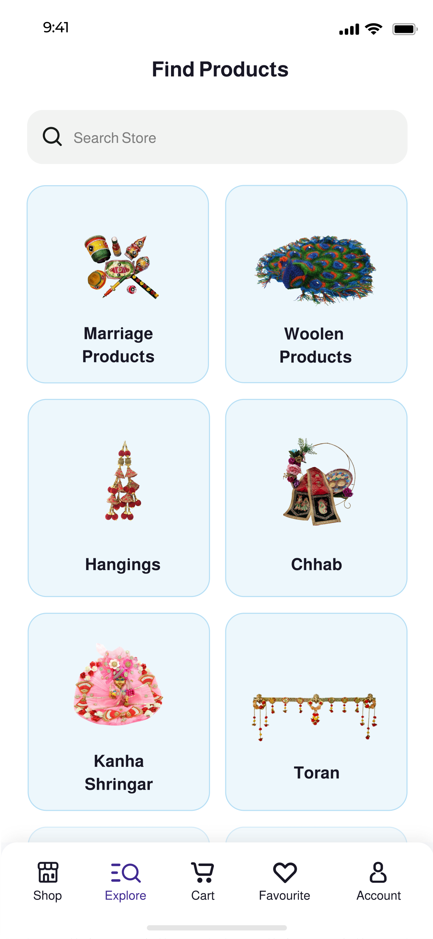
EXPLORE
This screen be reached by clicking Explore tab in bottom bar. Different categories of products will be listed here in different clickable card views.
Also, a search bar is provided to search products in this.

Slide 21
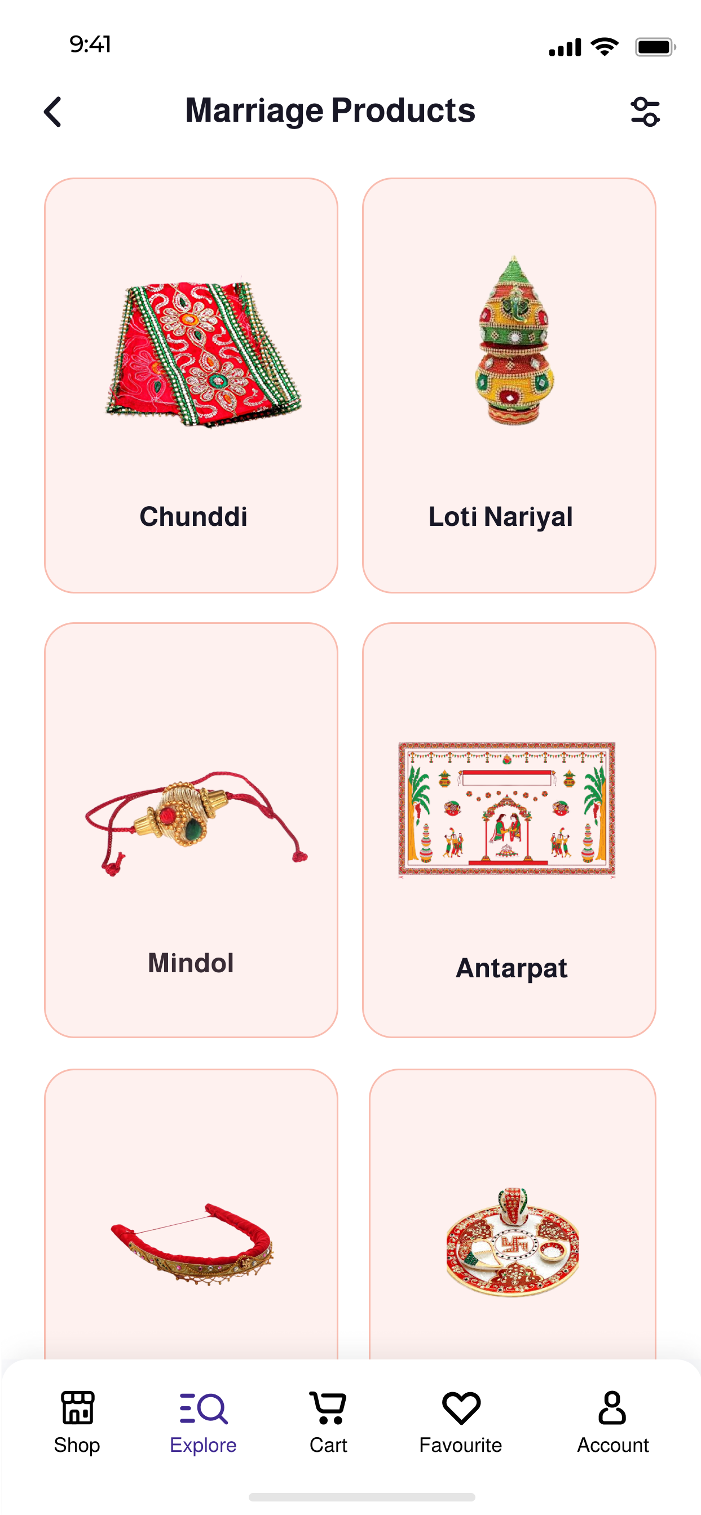
CATALOG
This screen is optional, and it will be displayed only if the user clicks the category which has a sub-category. It is very similar to previous screen.

Slide 22
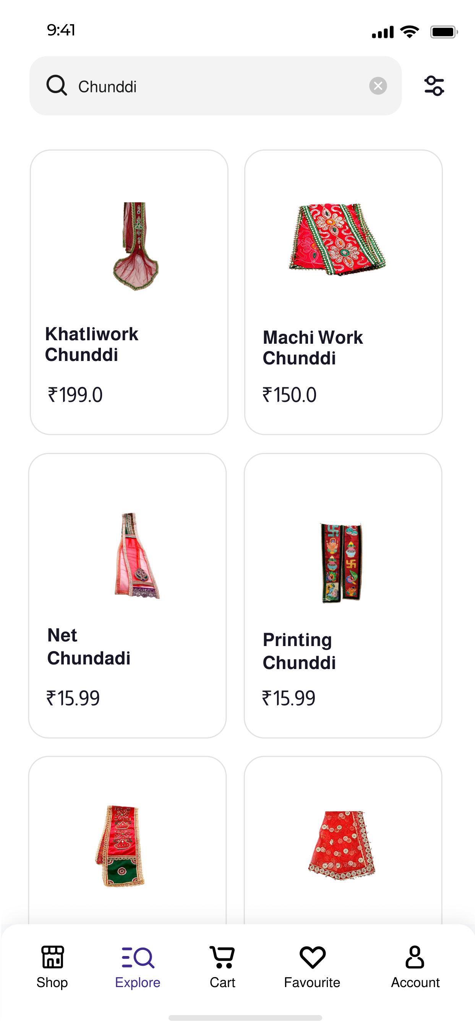
SEARCH
This screen will list the products of category selected by user from previous screen. It has search bar to search among products.
It has filter button on top right to apply filter and sort the products.

Slide 23
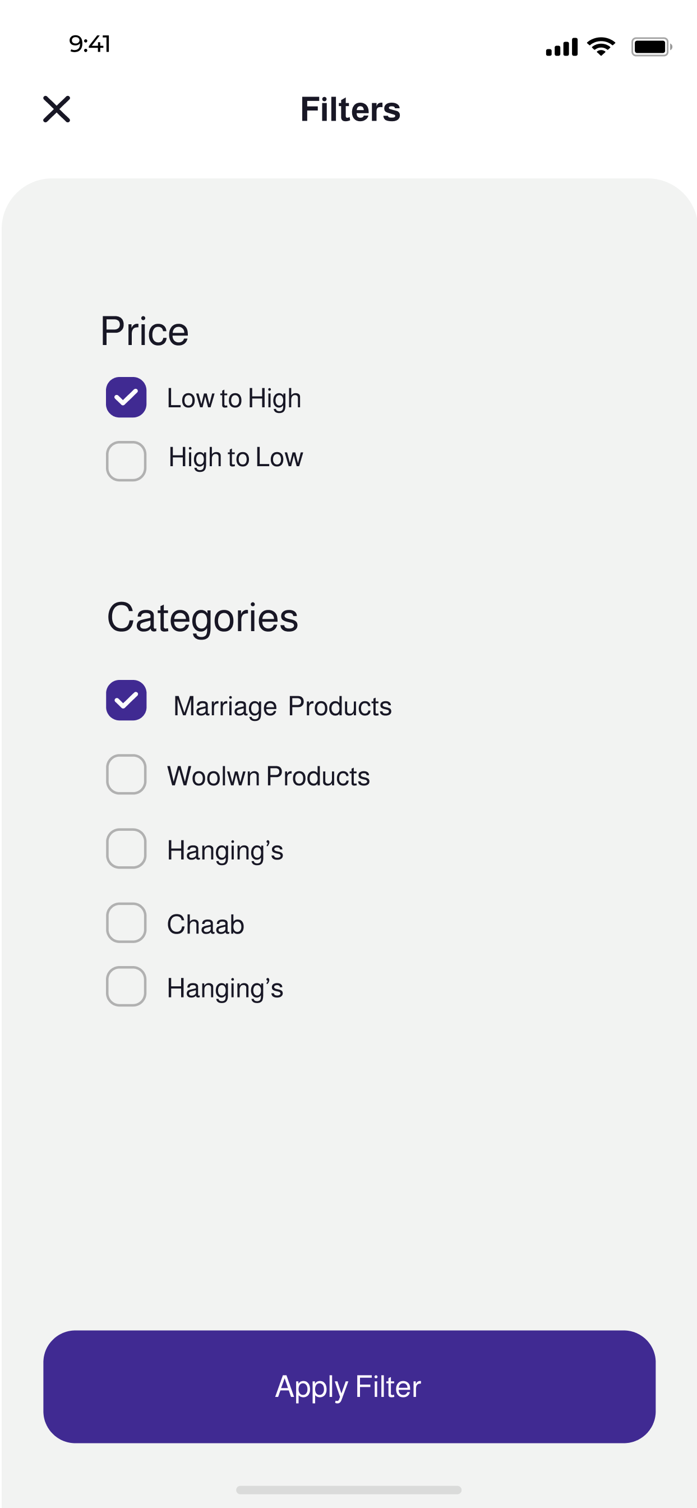
FILTERS
This is filter menu which will pop up when user click filter button on previous screen. It has option to select category of product and to sort the products according to price.
Apply Filter button will reload the screen with the product according to user selected options.

Slide 24
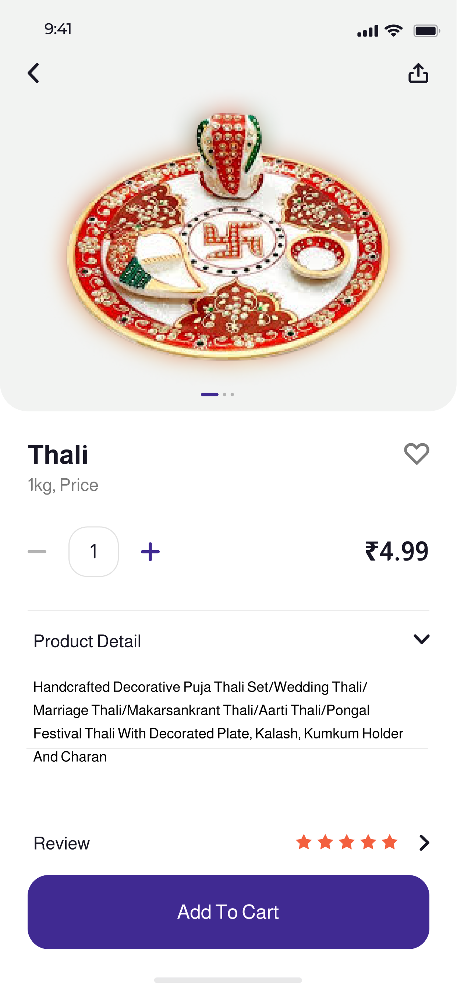
PRODUCT DETAILS
This screen shows the description and details of product after clicking the product from previously listed items.
Favourite button will add the product to favourite list.
Add to Cart button will add the item to cart.

Slide 25
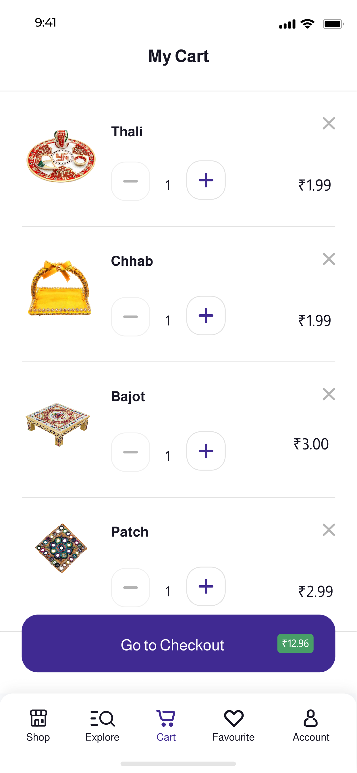
CART VIEW
Cart button in bottom bar will list all items in cart.
Clicking on each item will open description and details of item.
Onclick listener will take user to checkout and place the order by clicking Go to Checkout button.

Slide 26
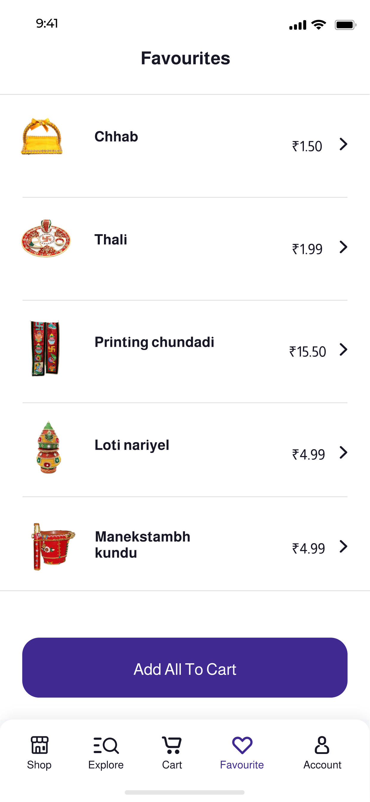
FAVOURITE LIST
Click on Favorite button in bottom bar will list all items in favorite list.
Clicking on each item will open description and details of item.
User can add all items from favorite list to cart by clicking Add All To Cart button below.

Slide 27
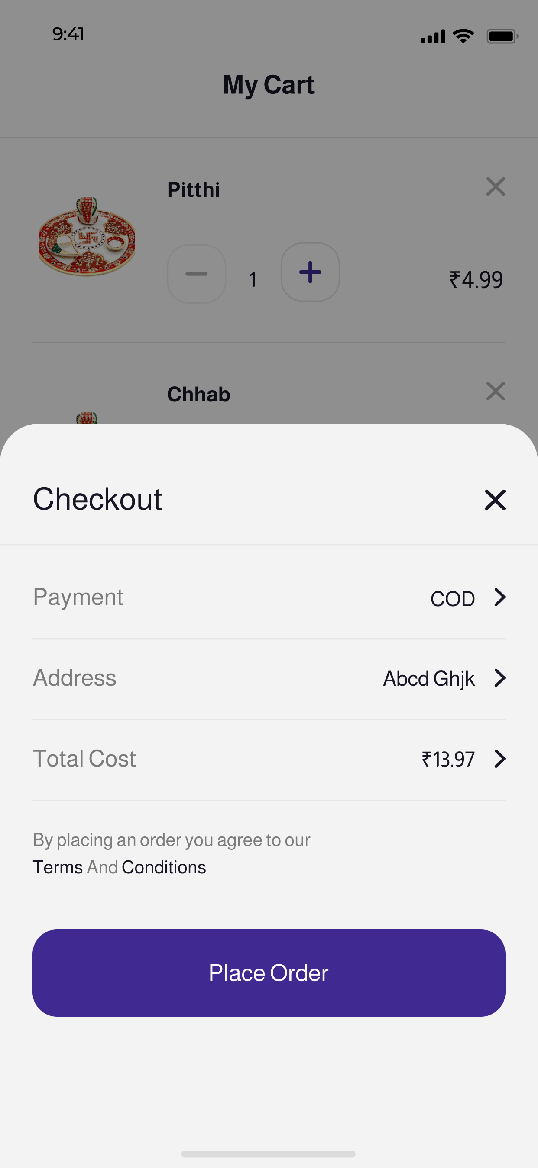
CHECKOUT
After clicking Checkout button in cart screen, user will be able to place order and this screen will be displayed.
It will allow user to select shipping address from the addresses saved in their profile and select payment method for payment.
Place Order button will confirm the order and check for valid user inputs.

Slide 28
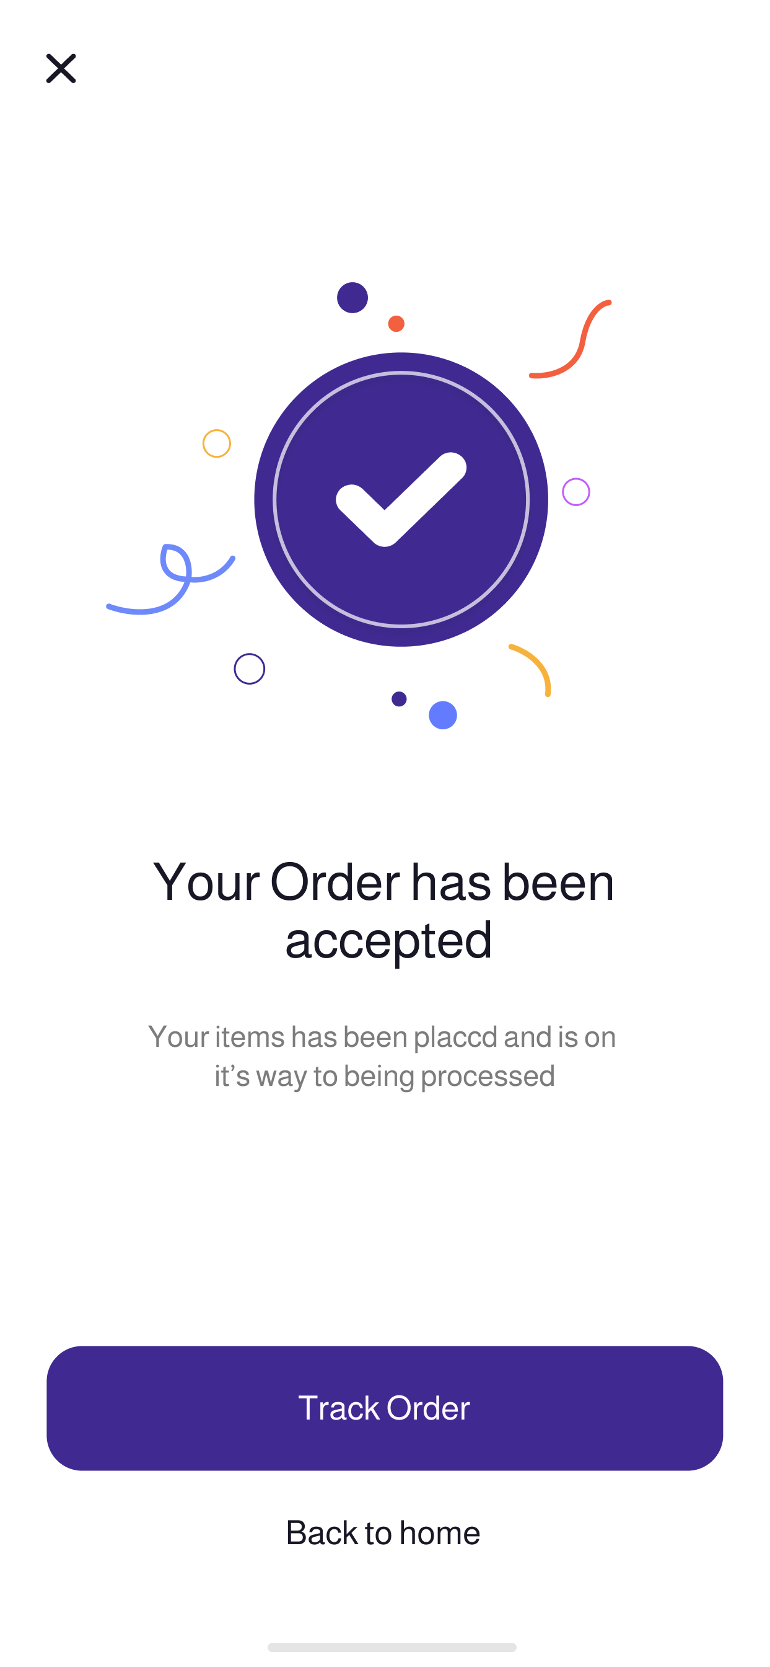
SUCCESS
This screen will be displayed when the user clicks Place Order button and the order is confirmed.
It contains two buttons Track Order - it will redirect the user to orders screen.
and Back to home – it will take the user to home screen.

Slide 29
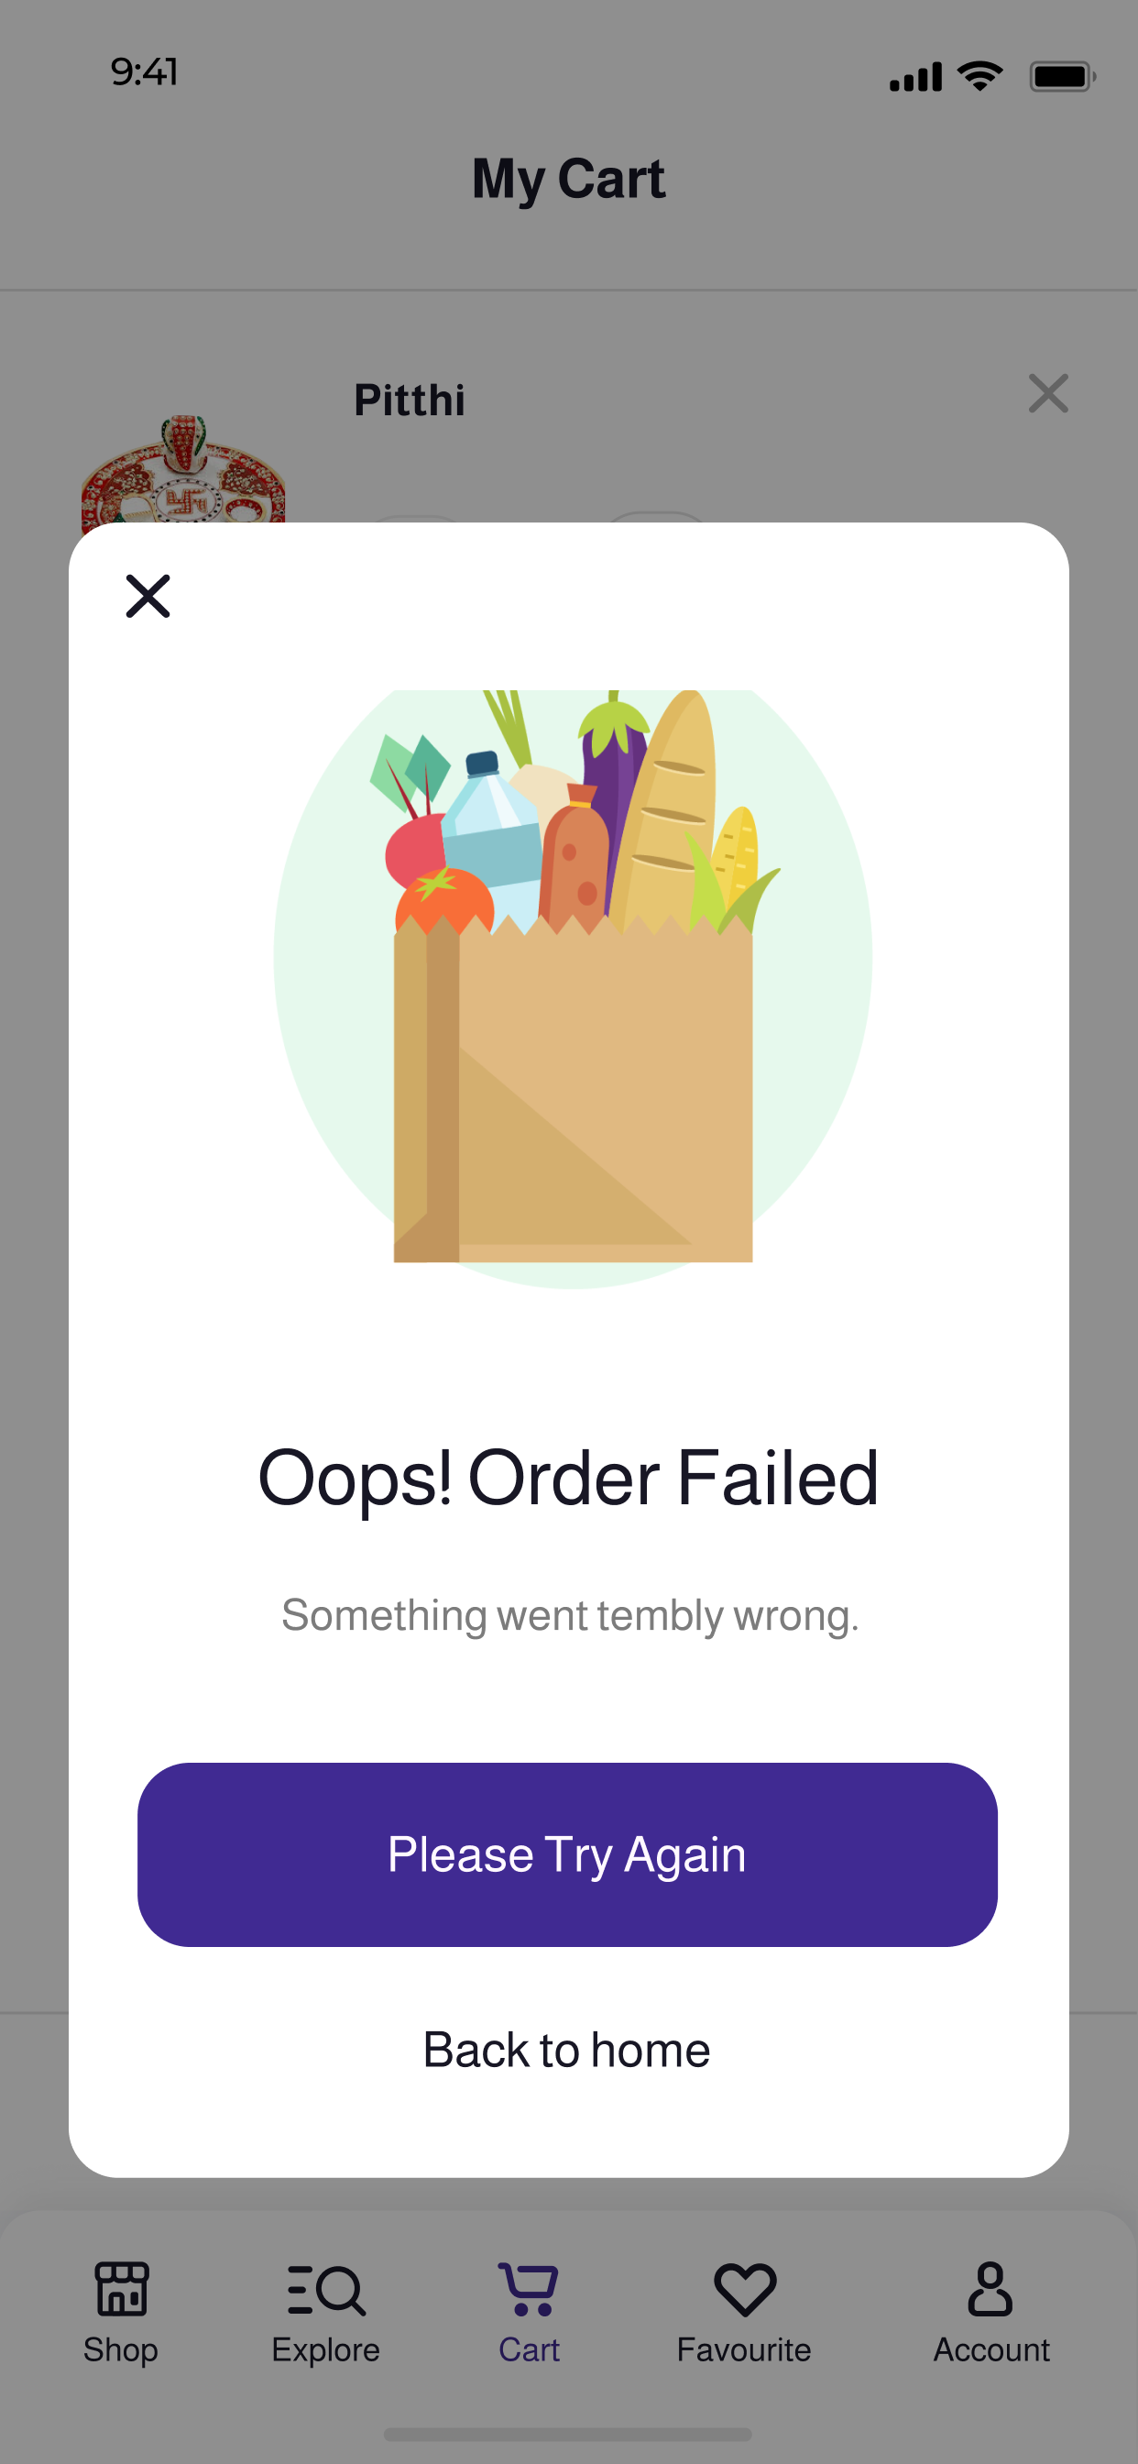
ERROR
This screen will be displayed if any exception or error occurs during confirmation of order.
It contains two buttons Please Try Again - it will call the checkout method again and try to confirm order.
and Back to home – it will take the user to home screen.

Slide 30
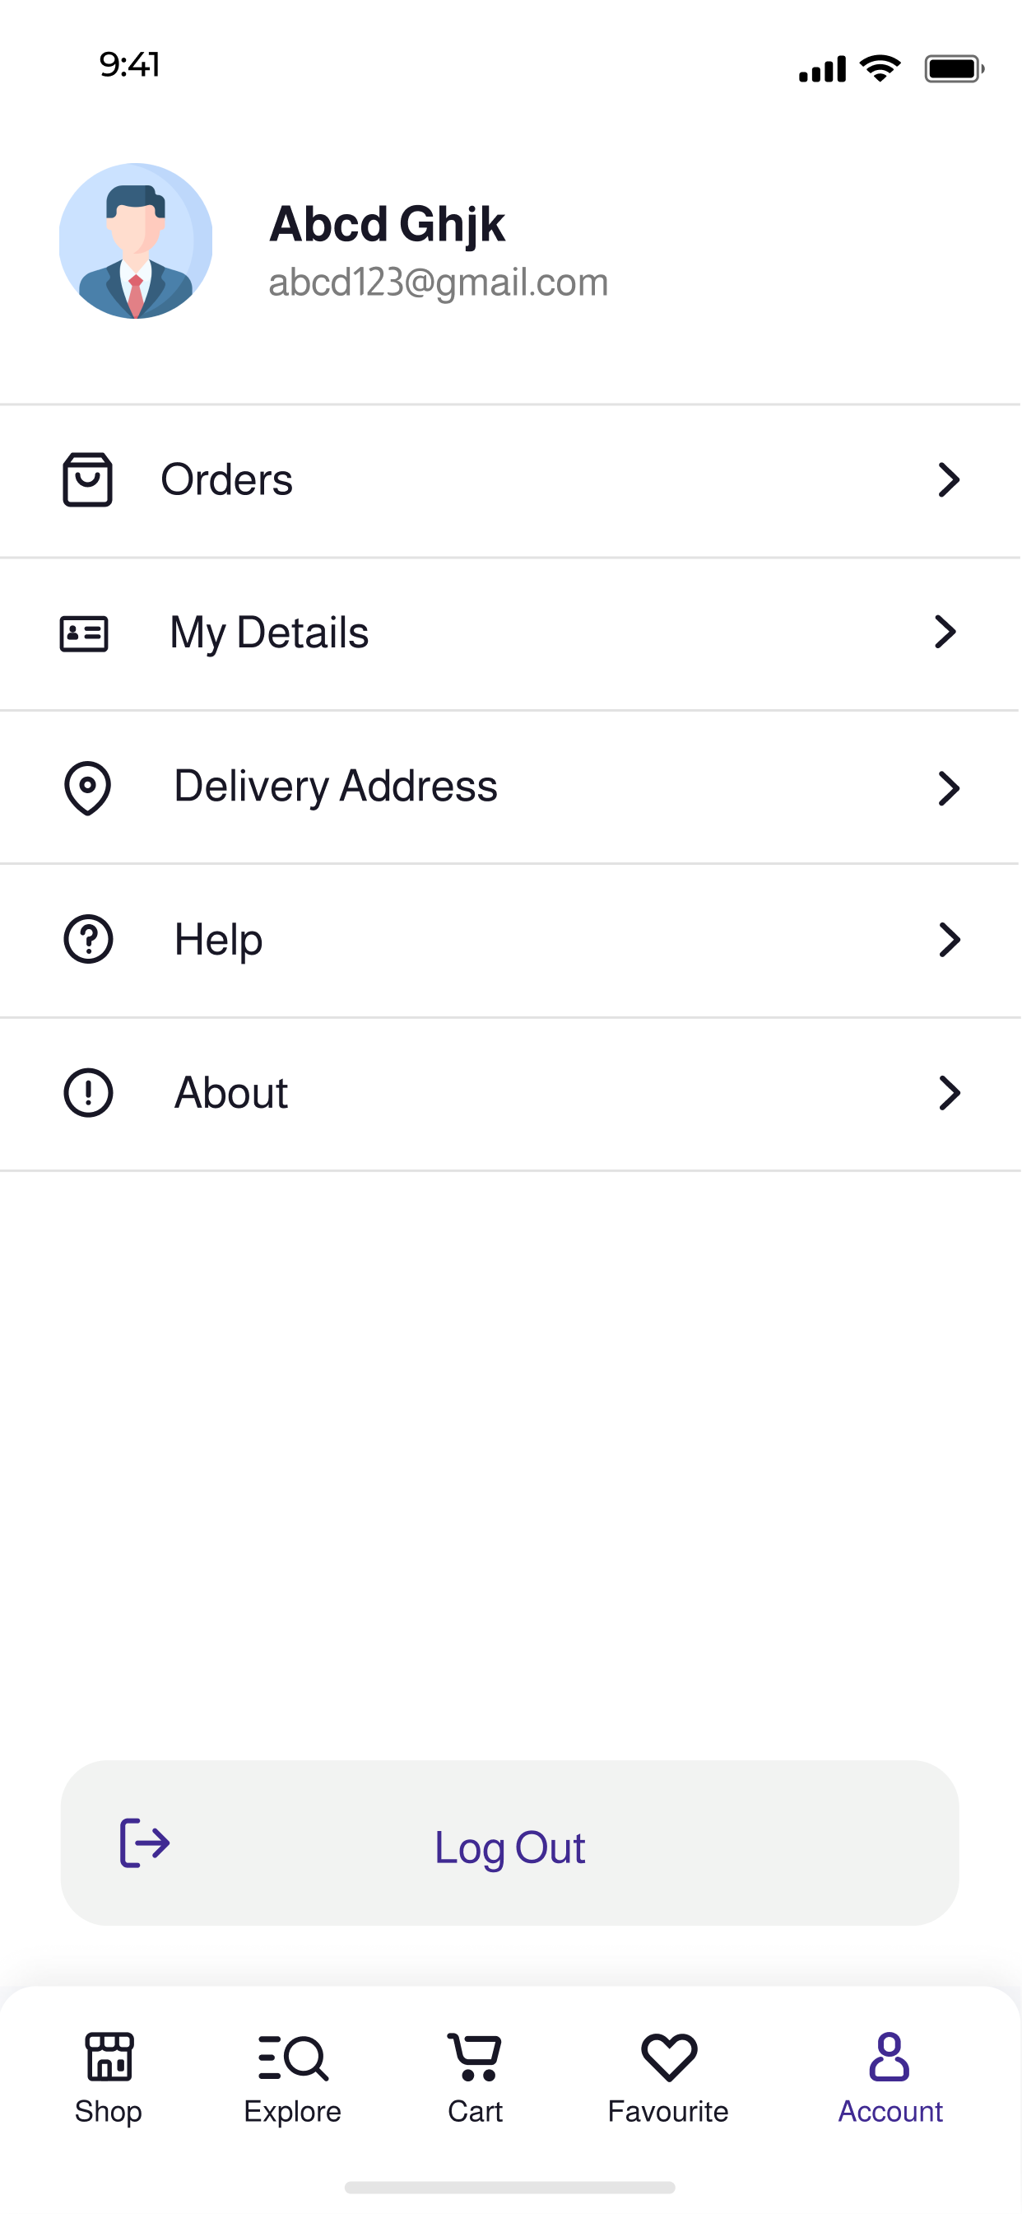
ACCOUNT
In Account screen, you can find buttons to view your orders, details, delivery address, help and about.
Clicking Logout Button will sign you out and end your session in session manager.

Slide 31
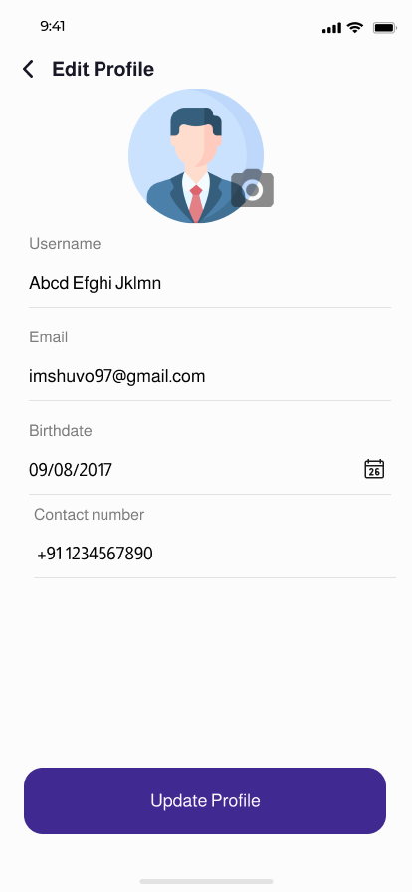
PROFILE
On clicking My Details button on account screen, user will be redirected to this screen from where he/she can update their information.

Slide 32
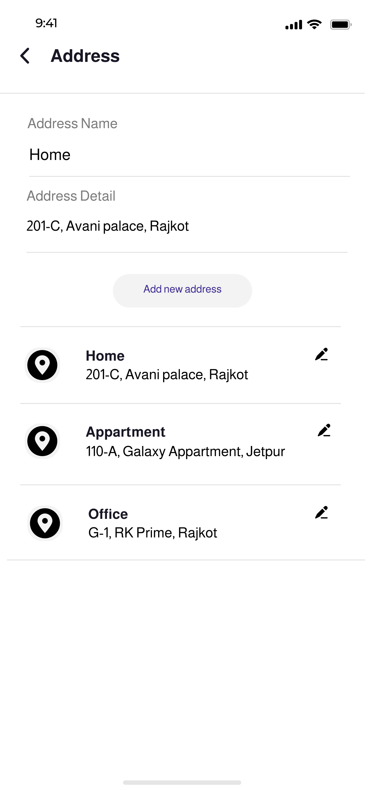
ADDRESS
On clicking Address button on account screen, user will be redirected to this screen from where he/she can add or update shipping address which will be used for delivering their orders.

Slide 33
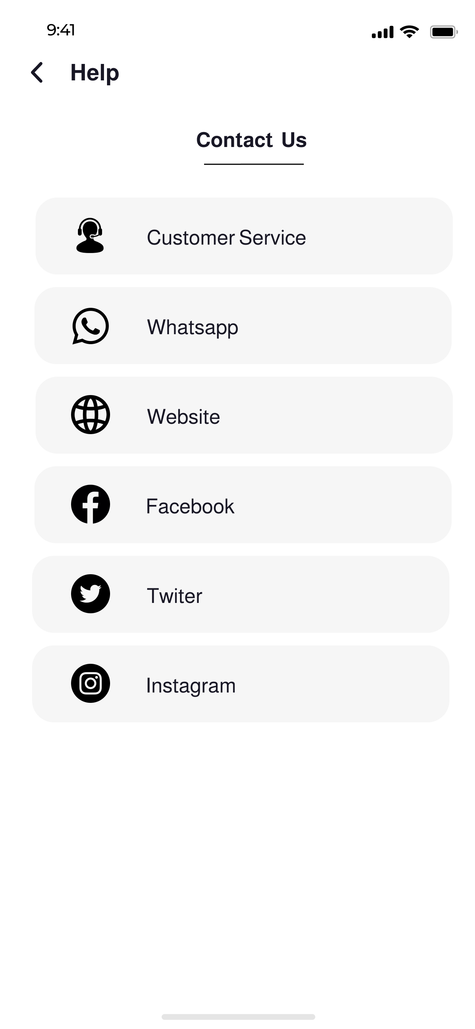
HELP
This screen will help the users to contact the admin (us) in case if they have any query or problem while using app which can solved manually

Slide 34
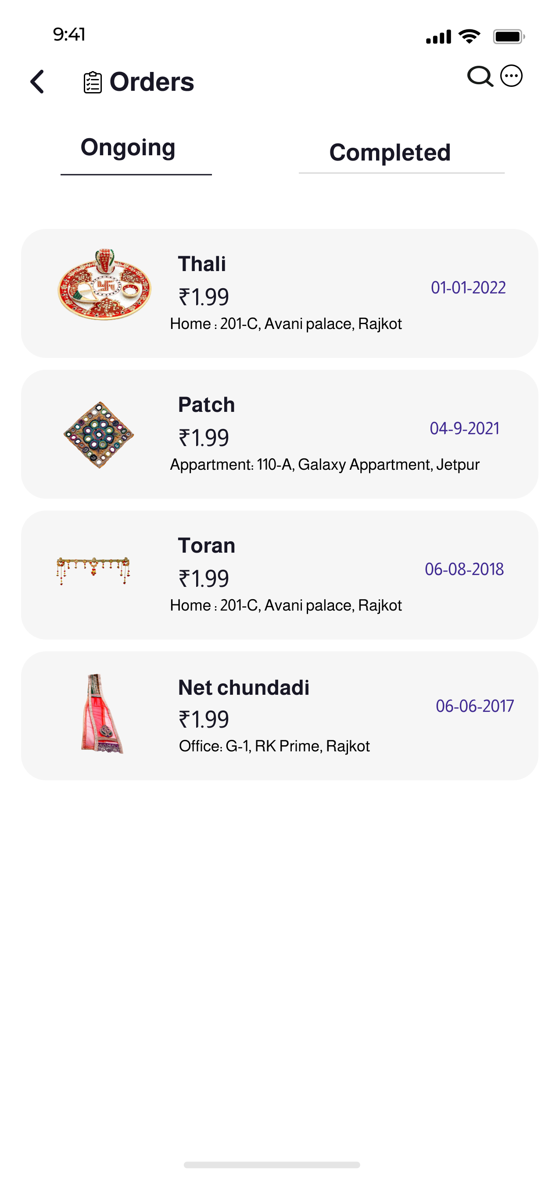
ORDERS(ONGOING)
Orders - Ongoing will display orders which are yet to be delivered.

Slide 35
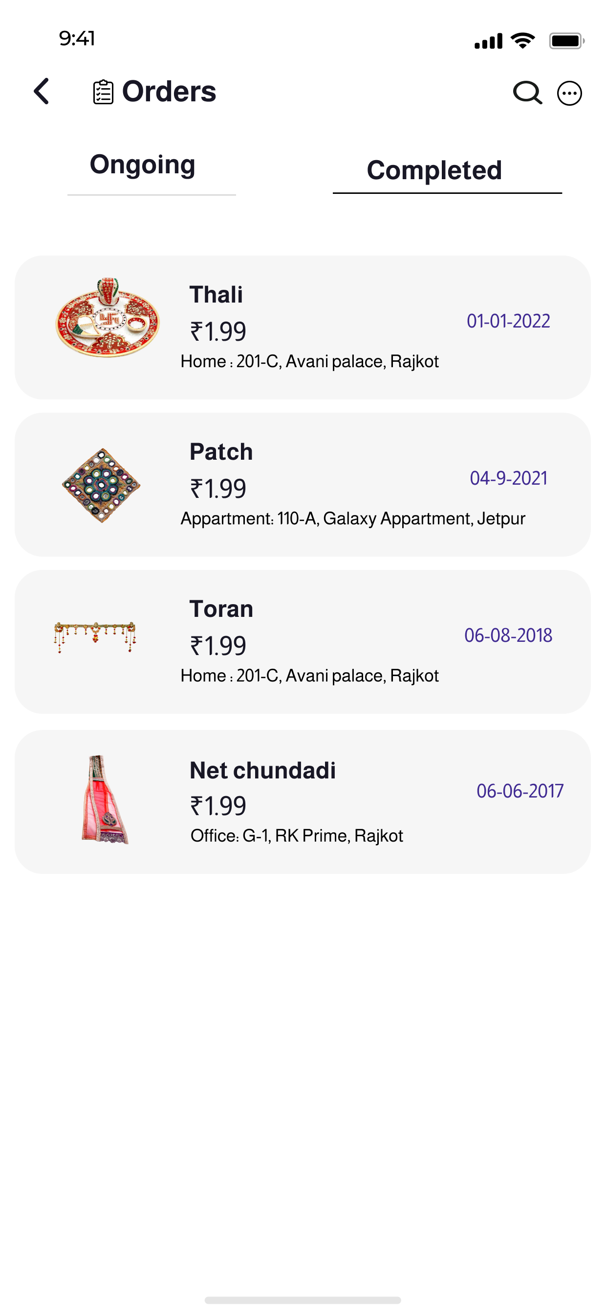
ORDERS(COMPLETED)
Completed will show all the previous orders that had been successfully delivered.

Slide 36
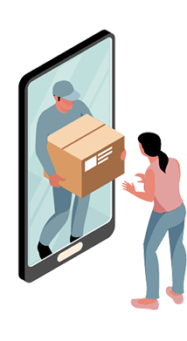
05
ANALYSIS MODEL
Flowchart & Diagrams

Slide 37
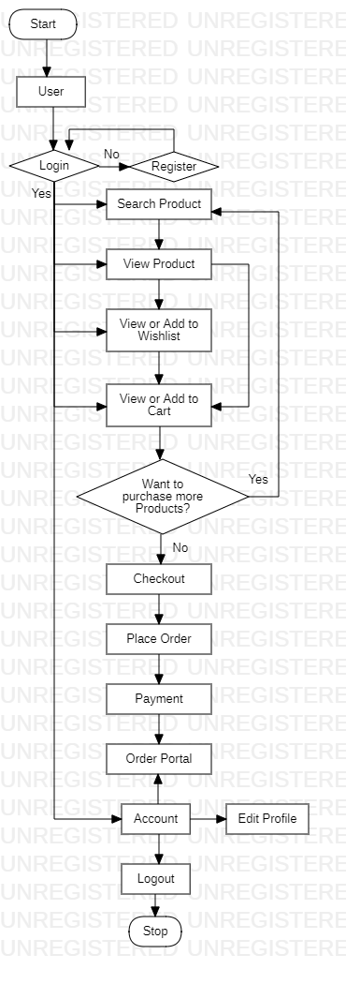
FLOW CHART

Slide 38
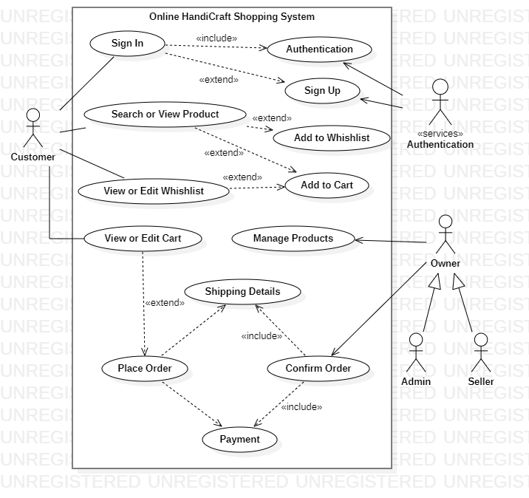
USE CASE DIAGRAM

Slide 39
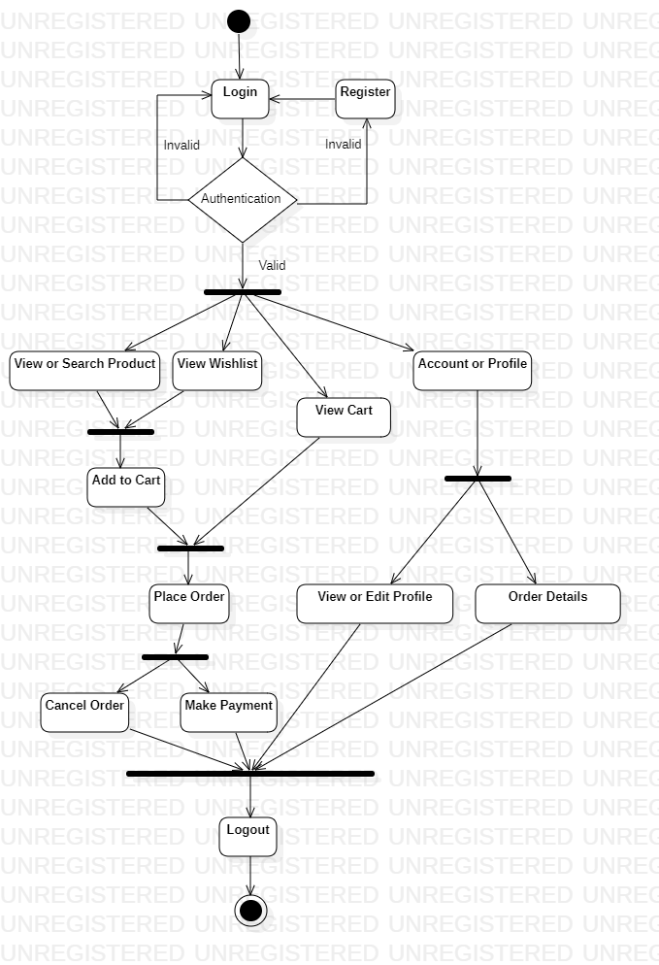
ACTIVITY DIAGRAM

Slide 40
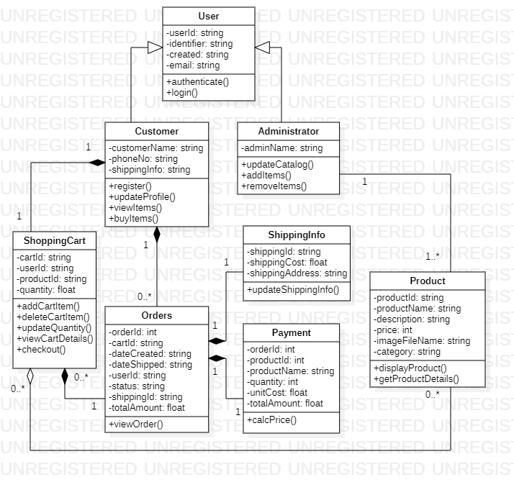
CLASS DIAGRAM

Slide 41
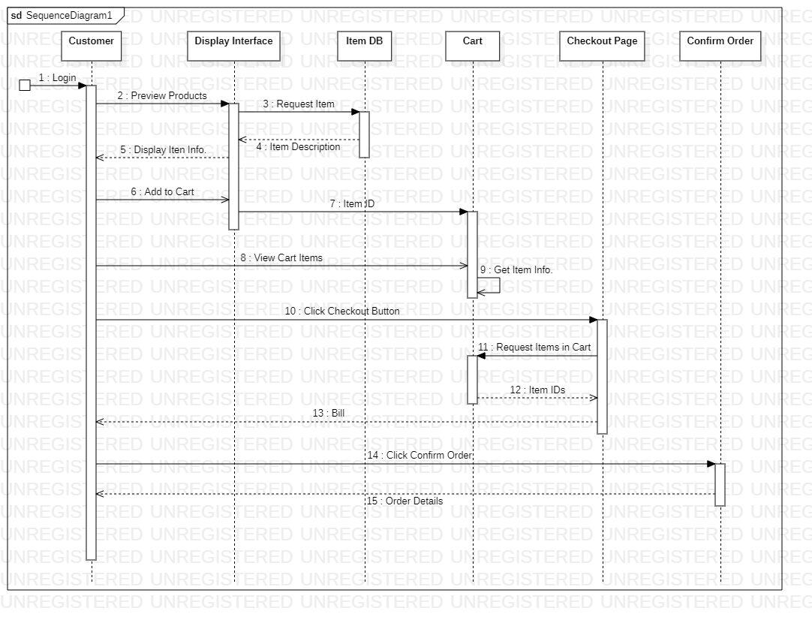
SEQUENCE DIAGRAM

Slide 42
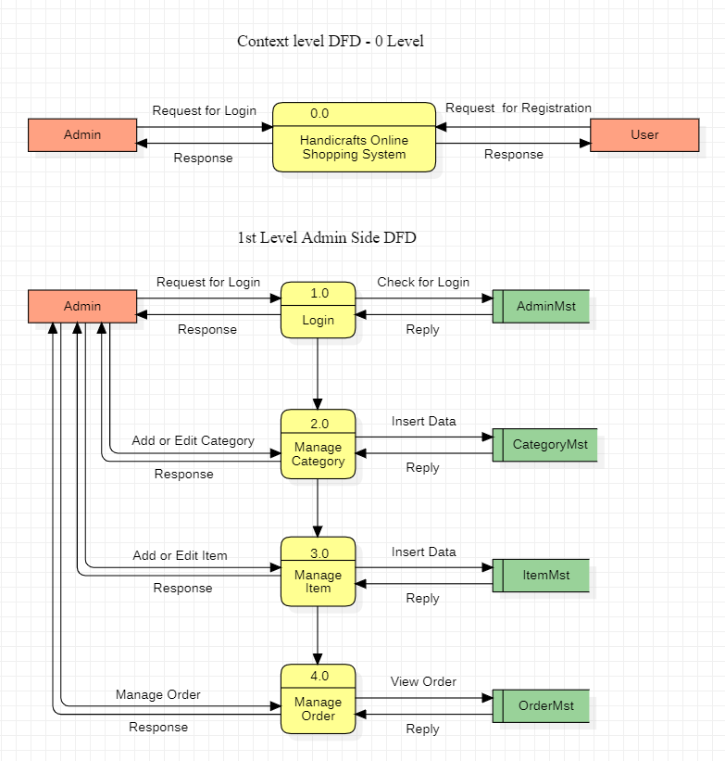
DATAFLOW DIAGRAM

Slide 43
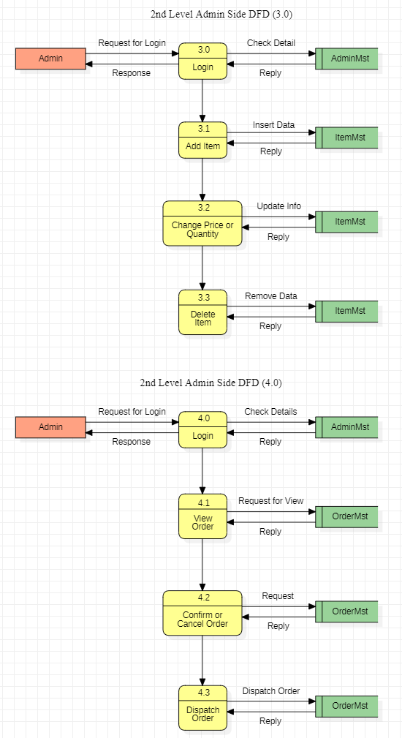
DATAFLOW DIAGRAM

Slide 44
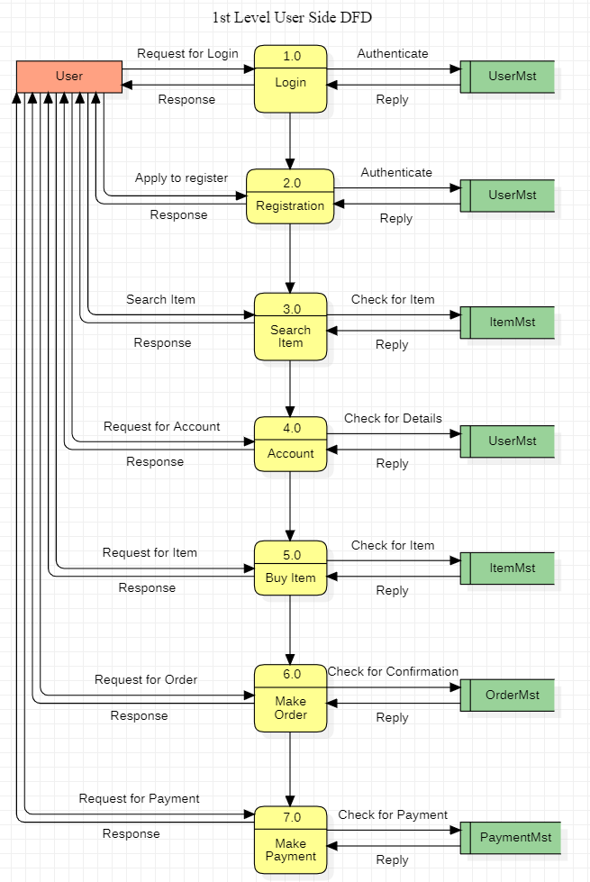
DATAFLOW DIAGRAM

Slide 45
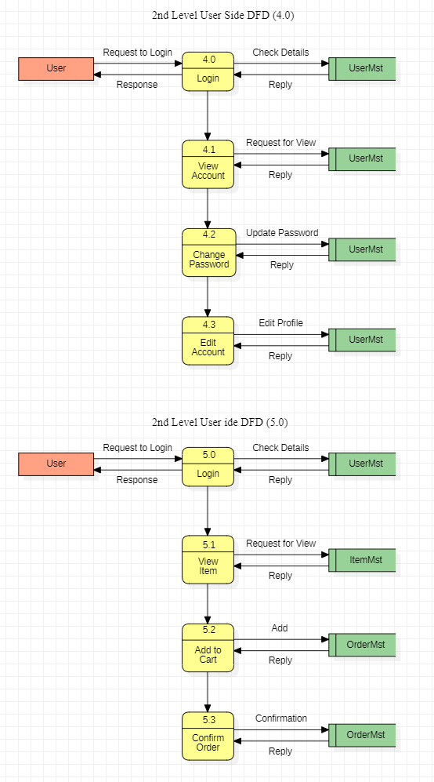
DATAFLOW DIAGRAM

Slide 46
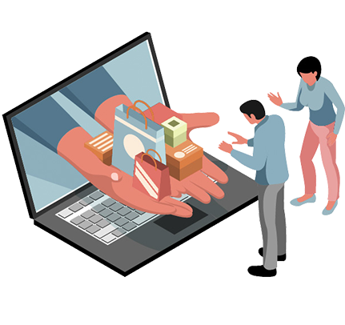
06
LIMITATIONS & FUTURE
Limitations and future scopes for our application

Slide 47
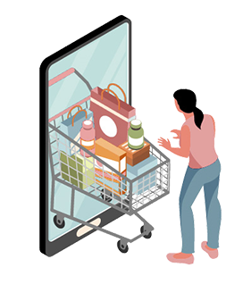
LIMITITIONS
Shopping app just like others but has only handcraft products.
Managing this app could be a difficult task as it require good data base management system and activity log storage.
Users may not trust easily during first purchase.
This app can be used for our personal business only.

Slide 48
FUTURE ENHANCEMENTS
Handicraft’s Galaxy
Frequently adding new products and adding other cultural product to expand the reach of the app to other regions
We would like to connect it to web in future for better management and flexibility
Addition of exciting and new offers on big holidays and festivals .

Slide 49
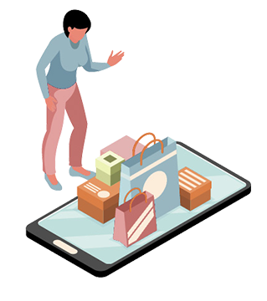
THANK YOU
Do you have any questions?

